Slide 1
Race & the Criminal Justice System
Fall 2020 Professor Gaston
Agenda
Week 8
October 20, 2020
Review course schedule
Essay #2 grading
Upcoming documentary
Lecture

Slide 2
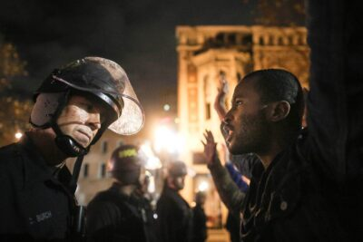
Race/Ethnicity & Policing
Tuesday
October 20, 2020

Slide 3
Overview
Complex and deep
Longstanding
Black American vs. Hispanic/Latinx American vs. Native American vs. White American

Slide 4
History
Dehumanization of people of color
Early forms of law enforcement
First police forces
Law enforcement and racialized social control
Race of police officers

Slide 5
Police Practices
Routine policing
  Patrol
  Surveillance
Stops
  Pedestrian stops
  Traffic stops
Frisks
Searches

Slide 6
Police Practices cont’d
Arrests
Calls for service

Slide 7
Use of force
Use of force
Non-fatal vs fatal force
Excessive force
Race/ethnicity and force

Slide 8
Perceptions of police
Racial/ethnic differences
Longitudinal trends
Police-community relations
Police legitimacy

Slide 9
Questions???
Notes:
Post your questions to the Discussion Forum for Week 8 Questions on iCollege

